Slide 1
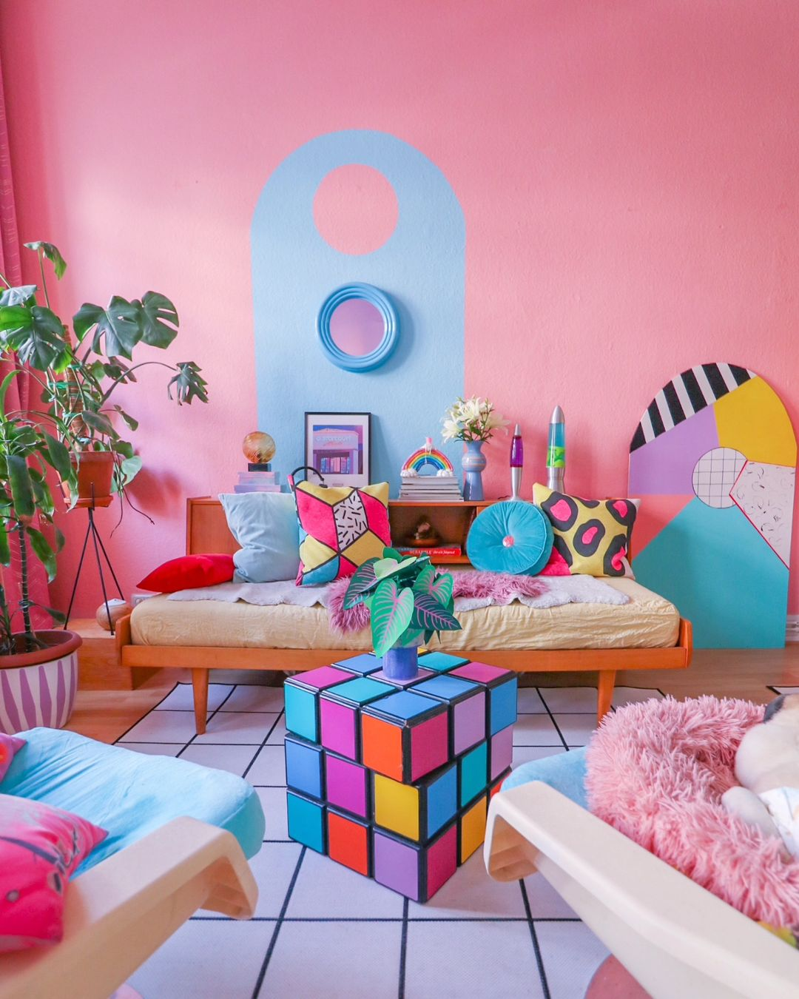
REAL LIFE SCENARIO CASE STUDY
TOPIC : HOME RENOVATION
PRESENTED BY: MUSKAN PRITAM

Slide 2

INTRODUCTION
We use Data Analytics in everyday life without even knowing it. There are so many instances where we use data analytics to plan and prepare the data given, to convert that data into information for using it in preparation of better future outcomes, such as while buying a car, choosing the best supplier for package delivery on time, choosing which career path to go for, etc.
One of the example we will see in this presentation related to real life Data Analysis is when we want to renovate our home according to our needs. There are multiple steps involved in this which we go through without even knowing them, such as planning what we actually want, preparing the items, money or any ideas that can be helpful, start the process of searching , analyzing among the idea which will fit the best, sharing and communicating with the family members and friends for feedbacks and suggestions , then at last we start the action.

Slide 3

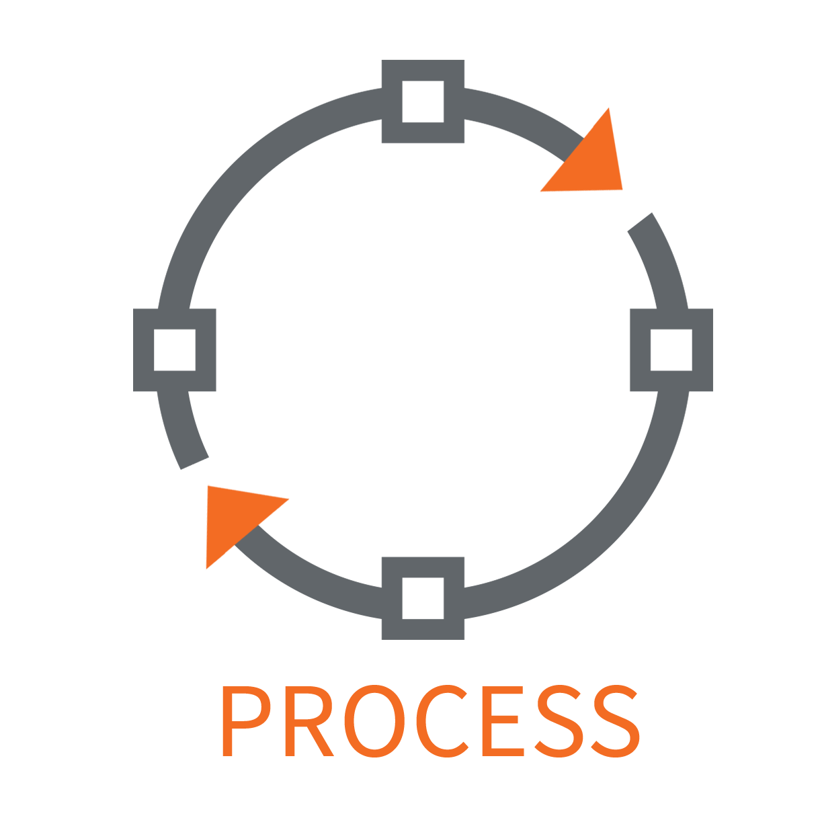


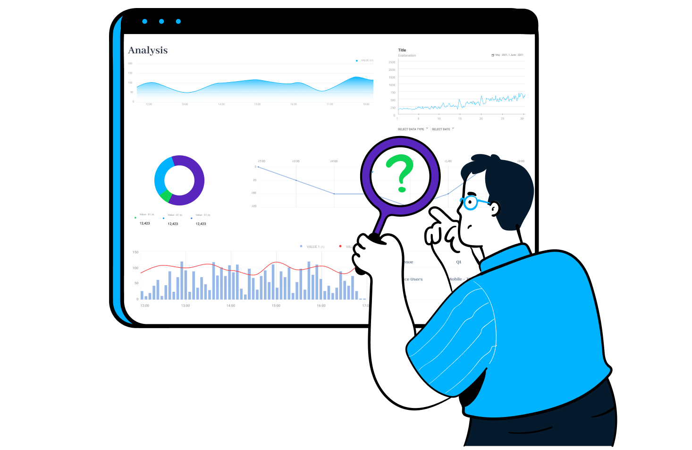
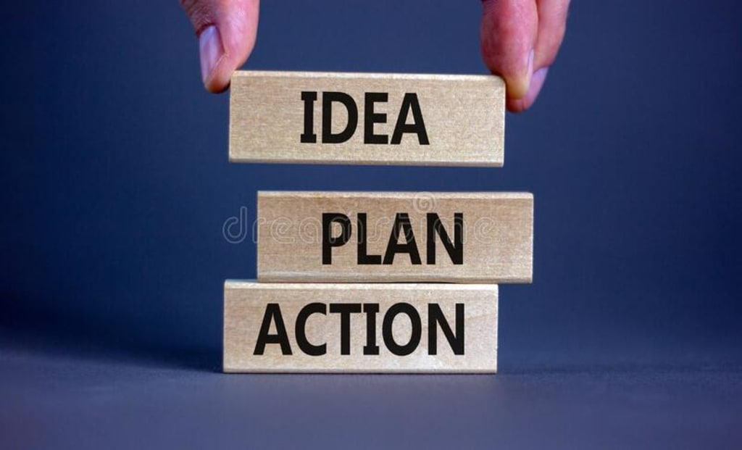
STEPS
PLAN
PROCESS
SHARE
PREPARE
ANALYZE
ACTION

Slide 4

PLAN
THE FIRST STEP WILL BE TO PLAN AND DEFINE WHAT ARE THE INITIAL THINGS WE NEED BEFORE STARTING THE RENOVATION OF OUR HOMES.
IDENTIFY WHAT WE WANT TO ACHIEVE WITH OUR RENOVATION AND DOES IT ALIGN WITH THE FINAL OUTPUT WE WANT.
IDENTIFY WHAT ARE THE THINGS THAT WE WILL NEED TO BUY.TO START IT.
IDENTIFY THE WALL PAINT COLOURS.
IDENTIFY THE HOME FURNITURES, ONE NEEDS TO BUY

Slide 5
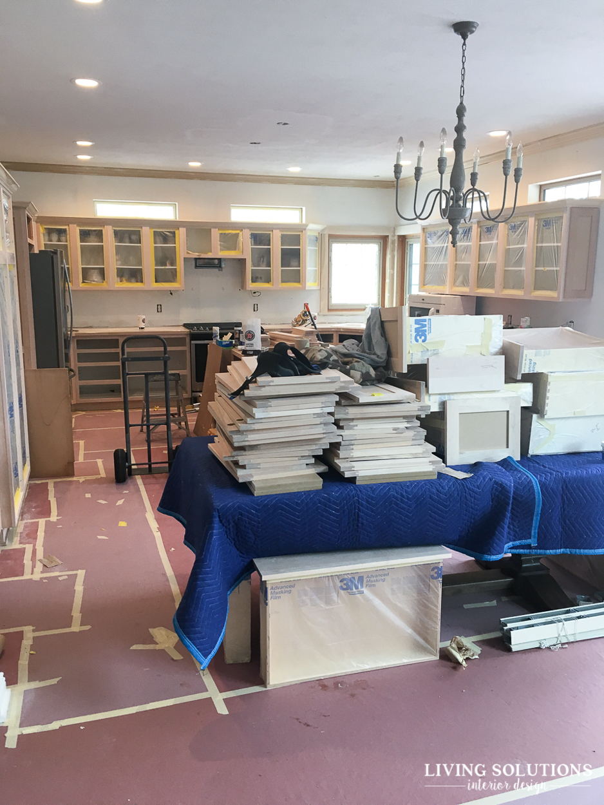
PREPARE
THE SECOND STEP WILL BE TO PREPARE FOR THE RENOVATION ACCORDING TO THE PLAN WE MADE IN THE FIRST STEP.
DETERMINE OUR BUDGET ALLOCATION FOR MATERIALS, LABOR AND UNEXPECTED COSTS.
GATHER DESIGN IDEAS FROM VARIOUS SOURCES AND CREATE A MOOD BOARD FOR INSPIRATION.
DECIDE IF WE NEED PROFESSIONALS LIKE ARCHITECTS OR CONTRACTORS.
CHOOSE MATERIAL AND FINALIZE DESIGN DETAILS KEEPING DURABILITY,COST AND AESTHETICS IN MIND.
PREPARE THE MIND AND HOUSE FOR RENOVATION.

Slide 6
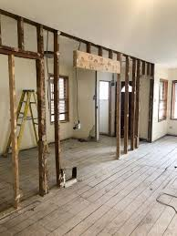
PROCESS
THE THIRD STEP WILL BE TO START THE PROCESS OF RENOVATING THE HOME.
CLEAR THE SPACE AND PROTECT BELONGINGS. CAN ARRANGE TEMPORARY LIVING IF NEEDED.
INSPECT THE PROCESS REGULARLY TO MAINTAIN QUALITY AND ADDRESS ISSUES PROMPTLY.
SEE FOR CONTRACTOR OR ARCHITECT AVAILABILITY.
WORK TOGETHER TO SEE WHAT TYPE OF DESIGN WE WANT IN DIFFERENT AREAS OF THE HOUSE.

Slide 7
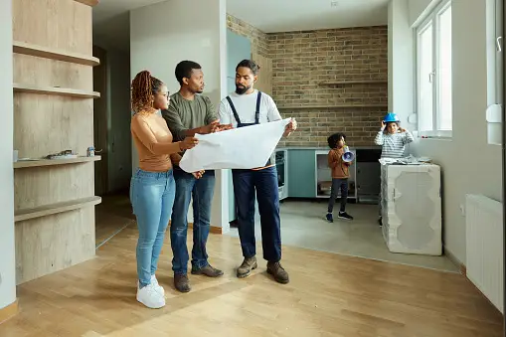
ANALYZE
THE FOURTH STEP WILL BE TO ANALYZE THE PLANNING AND PROCESS THOROUGHLY FOR ANY MISUNDERSTANDINGS OR ANY .
ANALYZE AND DEVELOP A TIMELINE CONSIDERING PERMITS, MATERIAL DELIVERY.
DISTINGUISH BETWEEN ESSENTIAL IMPROVEMENTS FOR FUNCTIONALITY AND OPTIONAL UPGRADES FOR AESTHETICS.
SEE FOR TRENDY OPTIONS RATHER THAN STANDARD ONES AVAILABLE IN MARKET.
SEE AND ANALYZE IF THE COLOR COMBINATION MATCHES WITH THE FURNITURE AND WALL ALONG WITH THE DESIGNS.
ANALYZE DIFFERENT PERSPECTIVES AND IDEAS

Slide 8

SHARE
THE FIFTH STEP WILL BE TO SHARE THE IDEAS AND PROGRESS WITH FAMILY MEMBERS AND FRIENDS.
THIS PROCESS IS IMPORTANT AS WE SHOULD TAKE FEEDBACKS FROM EVERYONE TO GET THE BEST OUTPUT.
CAN BE HELPFUL AND CHOOSING WHAT FITS THE BEST AND IS AVAILABLE IN LOW PRICE.
OTHER MEMBERS MAY GIVE THEIR INPUTS FOR THEIR SPACES IN THE HOME ACCORDING TO THEIR CHOICES
SHOULD COMMUNICATE WITH THE ARCHITECT WHAT SHOULD BE THE BEST TO DO.

Slide 9
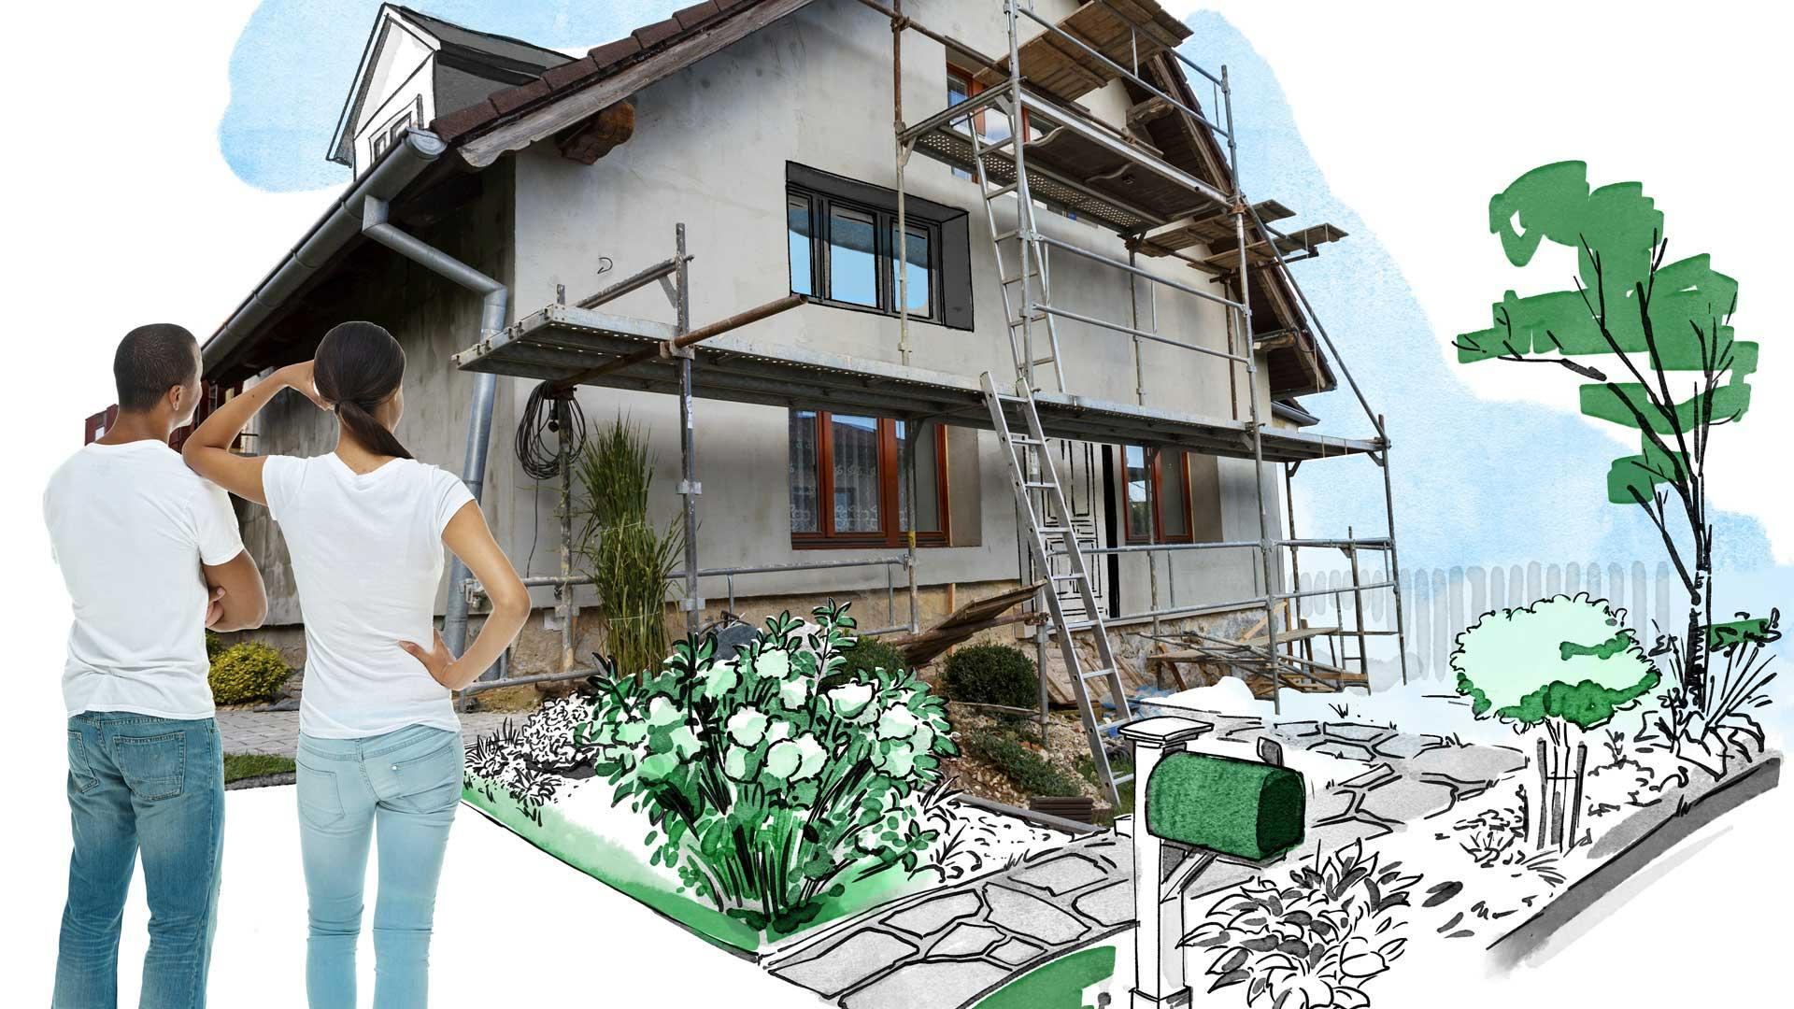
ACTION
THE SIXTH AND LAST STEP WILL BE TO EXECUTE THE PLAN MADE.
START THE RENOVATION KEEPING IN MIND THE ANALYSIS WE DID REGARDING THIS RENOVATION.
GO AHEAD AND MAKE YOUR HOUSE A DREAM HOME JUST WITH A FEW RENOVATIONS HERE AND THERE.
GO SIDE BY SIDE WITH THE ARCITECT TO SEE IF ALL THE ACTIONS ARE GOING IN A RIGHT WAY OR NOT.

Slide 10
CONCLUSION
LASTLY I WOULD LIKE TO CONCLUDE THIS PRESENTATION.
THIS CONCLUSION INTEGRATES THE CASE STUDY TO ILLUSTRATE THE REAL WORLD IMPACT OF DATA DRIVEN DECISION MAKING IN HOME RENOVATION. WITH DATA-DRIVEN INSIGHTS, WE CAN TURN THEIR RENOVATION DREAMS INTO REALITY WHILE MAXIMIZING VALUE AND SATISFACTION.
AS WE LOOK AHEAD , DATA ANALYSIS WILL CONTINUE TO PLAY A PIVOTAL ROLE IN SHAPING THE FUTURE WITH ITS WIDE AND EASY USE FOR BETTER PRODUCTIVITY.

Slide 11
THANK
YOU

